Slide 1
Lattices and Boolean Algebra
by
Dr. T. M. Rajalaxmi
Assistant Professor
Department of Mathematics

Slide 2
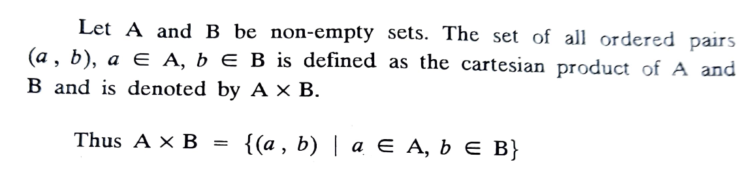
Cartesian Product of sets
We will discuss two algebraic systems known as Lattices and Boolean algebra.
Cartesian product of sets

Slide 3
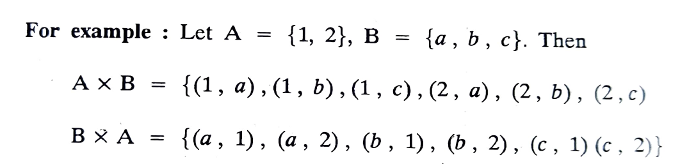
Cartesian Product of sets
Example

Slide 4
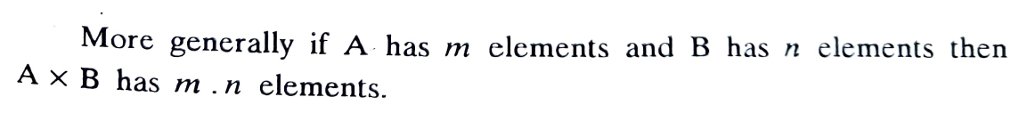
Cartesian Product of sets
Note
2.

Slide 5
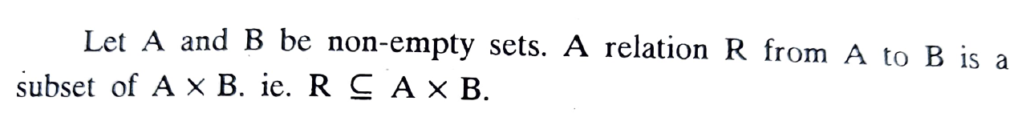
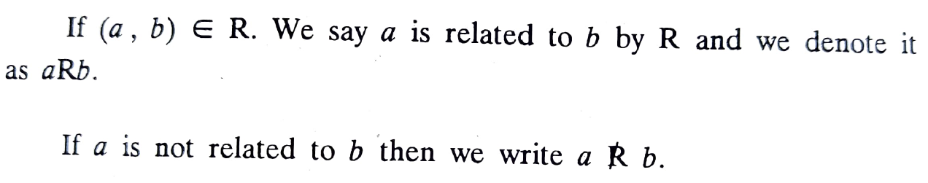
Relation from $A$ to $B$
Definition:

Slide 6
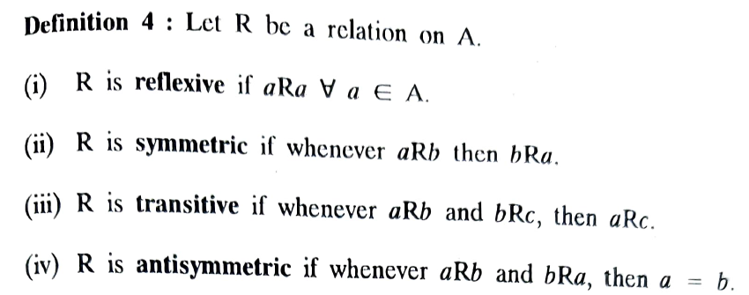

Relation on $A$
Definition:
Properties of relations on $A$

Slide 7
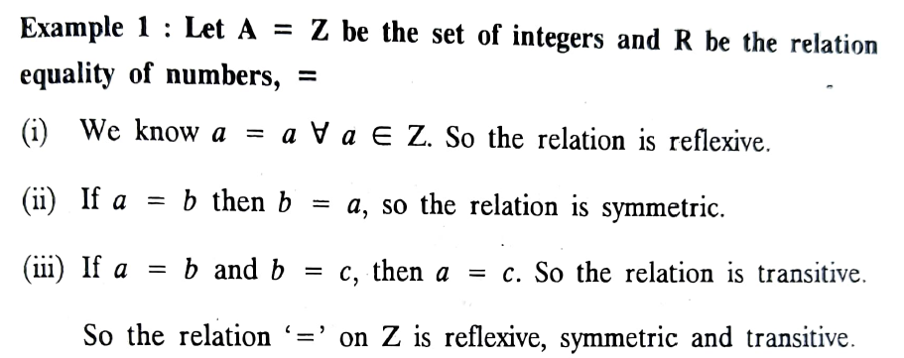
Relation on $A$
Example 1

Slide 8
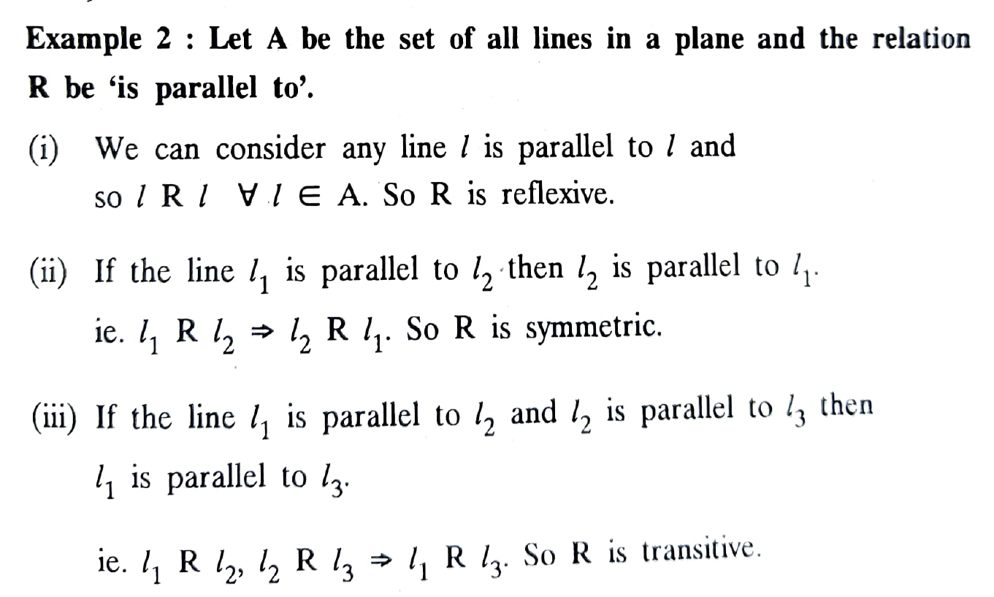
Relation on $A$
Example 2

Slide 9
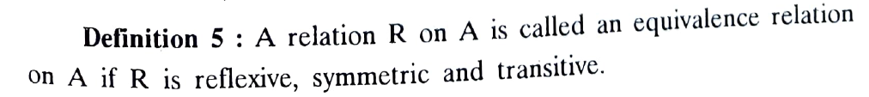
Equivalence Relation
Definition

Slide 10
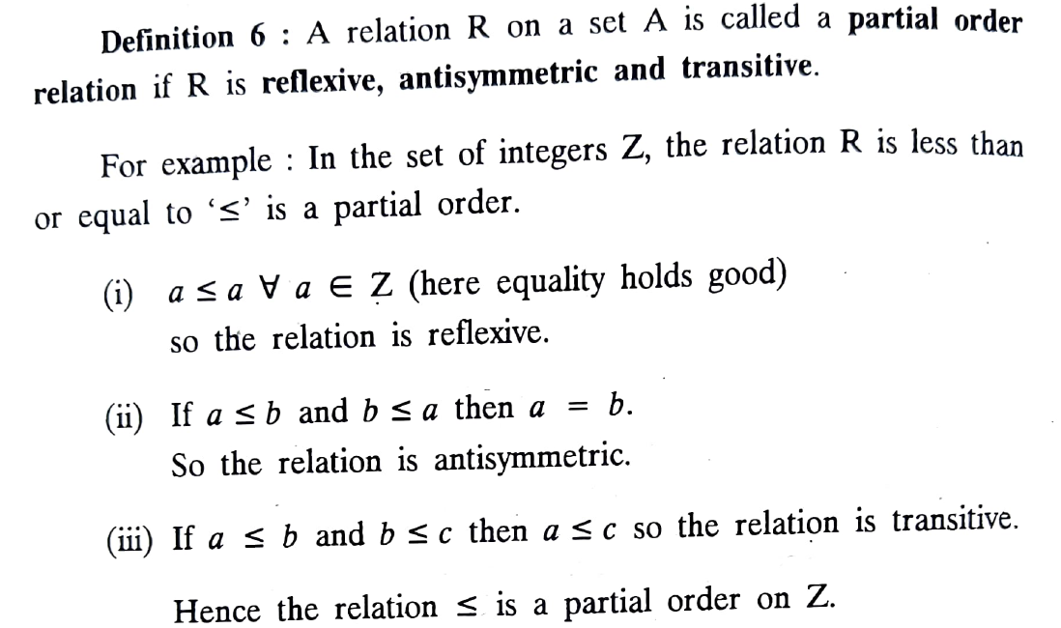
Partial order relation
Definition

Slide 11
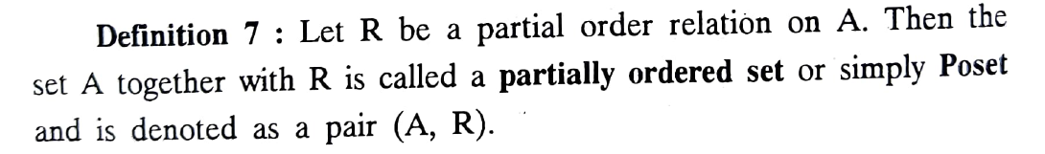
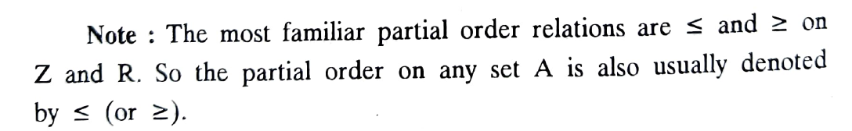
Poset
Definition
Note

Slide 12
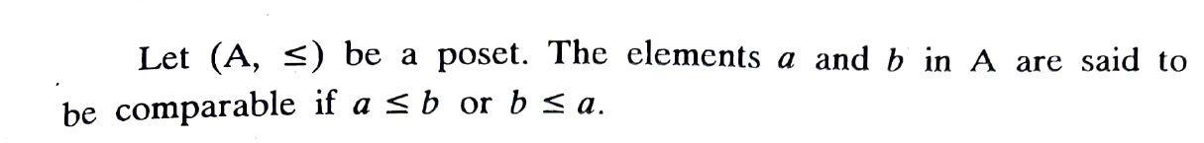
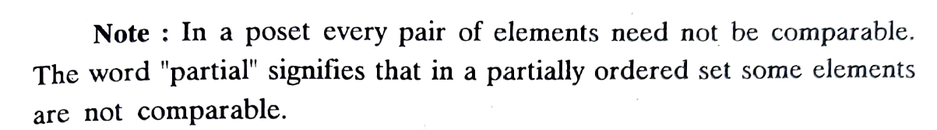
Comparable Elements
Definition
Note

Slide 13
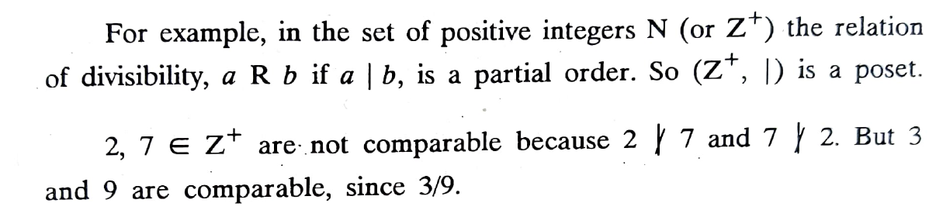
Comparable Elements and Total ordering
Example

Slide 14
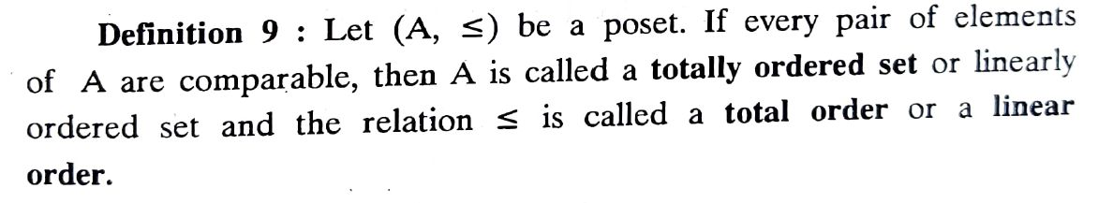
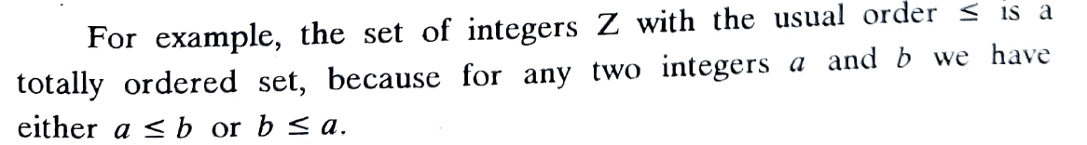
Total ordered set or linearly ordered set
Definition

Slide 15
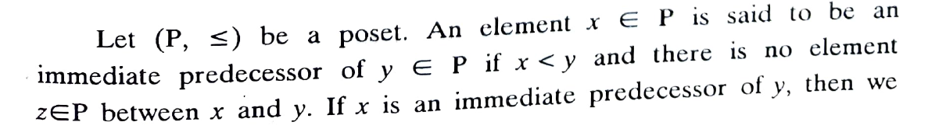
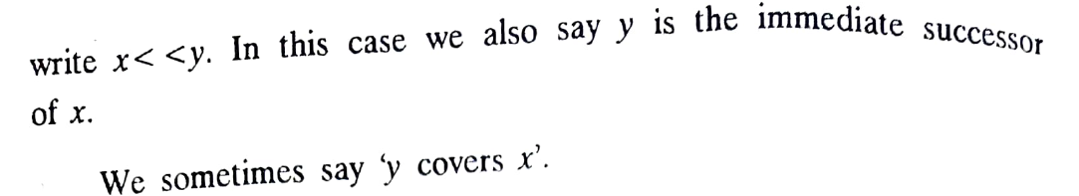
Immediate Predecessor
Definition

Slide 16
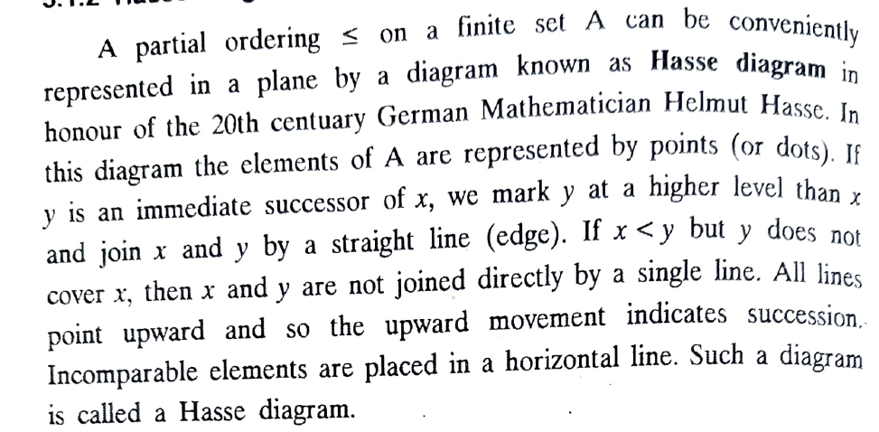
Hasse diagram
Definition

Slide 17
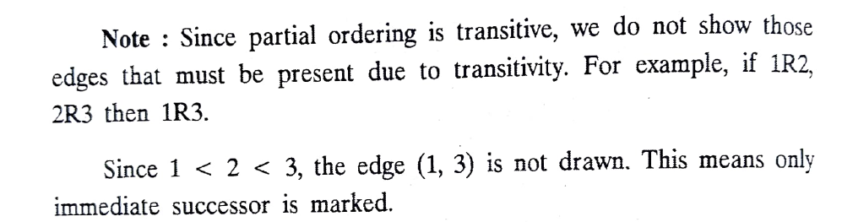
Hasse diagram

Slide 18

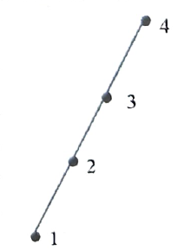
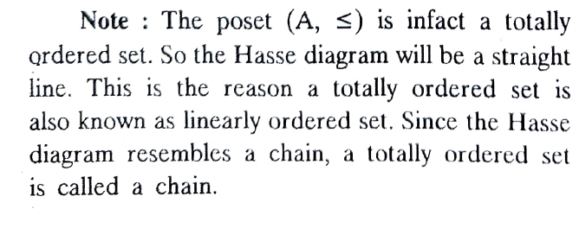
Hasse diagram - Examples

Slide 19
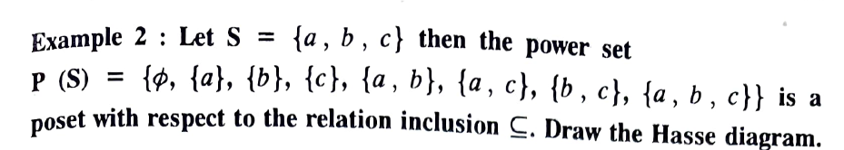
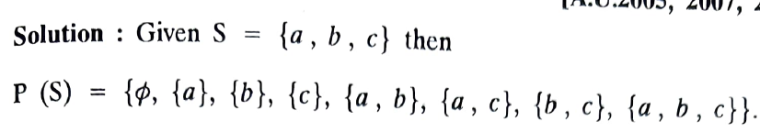
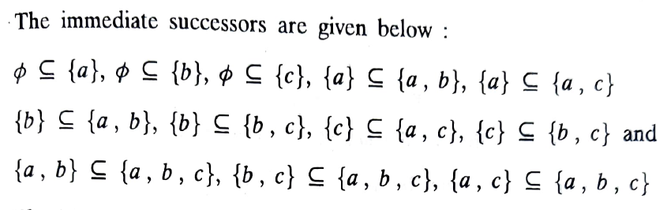
Hasse diagram - Examples

Slide 20
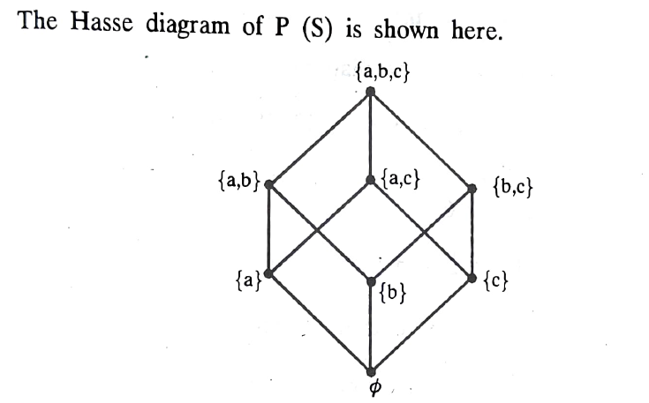
Hasse diagram - Examples

